Slide 1






Active Lives Survey:
A survey of Adult Data (Ages 16+) that measures sport and physical activity across England.
Data Analyst Skills Bootcamp: Portfolio and Evidence
Becky Potter
Datasets: https://activelives.sportengland.org/

Slide 2

Active Lives Data:
The Active Lives Survey is an Official Statistic from Sports England.
Sport England subscribes to the UK Code of Practice for Official Statistics.
The datasets are available via the Active People Interactive Tool.
In this project I am performing data analysis on:
Adult Data (Ages 16+) across England
All Activity Groups (90 Activities)
I will analyse data filtered by the following demographics:
Whole population from 2017 - 2023
Gender
Age
Faith
Work status
Education status
General Health
Datasets: https://activelives.sportengland.org/

Slide 3
Project Objectives:
Are activity patterns affected during the COVID-19 Pandemic?
What am I trying to achieve or learn from the datasets?
Whole population from 2017 – 2023: Analyse activity trends over a six-year period to spot patterns.
Gender: Analyse data to identify any correlations between gender and activity.
Age: Analyse data to identify any correlations between age and activity.
Faith: Analyse data to identify any correlations between faith and activity.
Work status: Analyse data to identify any correlations between work status and activity.
Education status: Analyse data to identify any correlations between education status and activity.
General Health: Analyse data to identify any correlations between general health and activity.
How does faith affect
activity preferences in mind-body exercises, e.g., yoga and Pilates?
What are the most popular exercises for those with different levels of health, e.g., good/bad.
Datasets: https://activelives.sportengland.org/

Slide 4
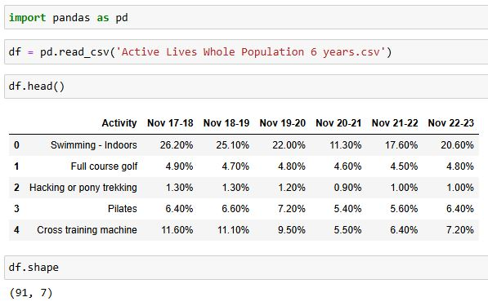
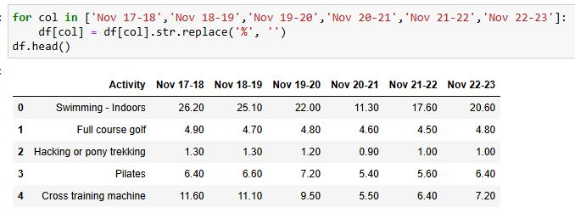
Whole population from 2017 – 2023:
Data Cleaning and Preprocessing:
df[col].str.replace('%', ‘’) This code removes the percentage sign from the years columns specified in the dataframe. This is a useful step before converting strings into numeric format.
We can see from loading the data and running df.shape that the dataframe has 91 rows (activities) and 7 columns (years).
Datasets: https://activelives.sportengland.org/

Slide 5
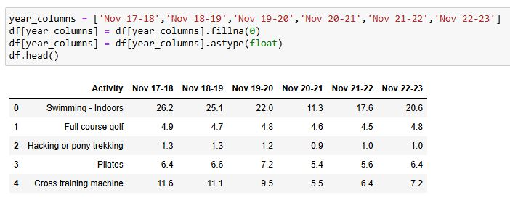
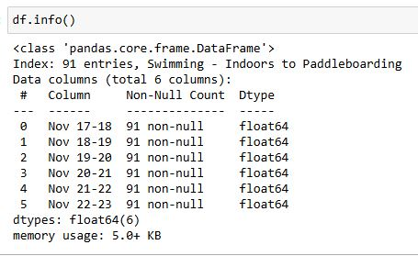
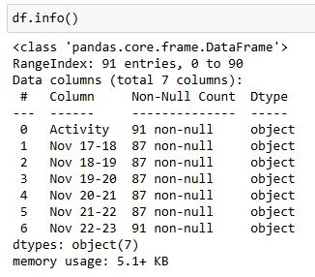

Whole population from 2017 – 2023:
Data Cleaning and Preprocessing:
df.info() shows the data has missing values and the data type is an object.
df[year_columns] = df[year_columns].fillna(0) replaces any NaN values with 0.
df[year_columns] = df[year_columns].astype(float) converts data type to float.
These lines prepare the data for numeric analysis, useful for performing mathematical operations.
Datasets: https://activelives.sportengland.org/

Slide 6
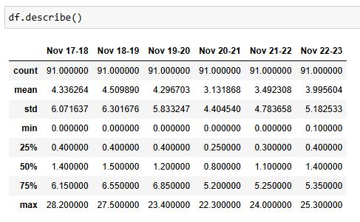
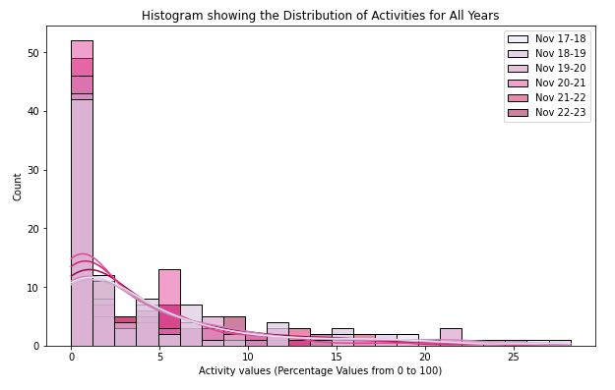
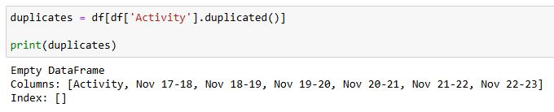
Whole population from 2017 – 2023:
Data Cleaning and Preprocessing:
The values in this dataframe are percentages.
The histogram and df.describe shows that all values are between:
0 and 28.2%.
There are no duplicates in the Activity column
Datasets: https://activelives.sportengland.org/

Slide 7
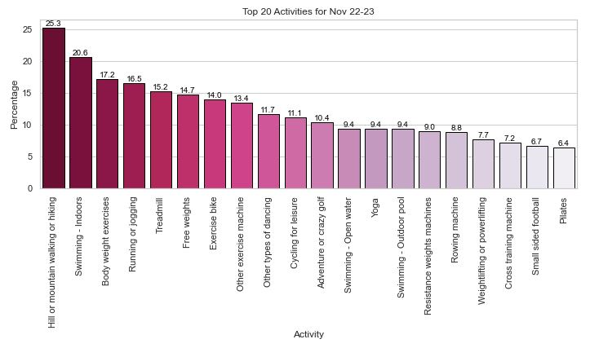
Whole population from 2022 – 2023:
To begin to understand the data, I selected the most current year (Nov 2022 – Nov 2023) and created a barplot using seaborn to show the top 20 activities.
The top 10 activities which adults participated in for this year are:
Hill or mountain walking or hiking (25.3%)
Swimming – Indoors (20.6%)
Body weight exercises (17.2%)
Running or jogging (16.5%)
Treadmill (15.2%)
Free weights (14.7%)
Exercise bike (14.0%)
Other exercise machine (13.4%)
Other types of dancing (11.7%)
Cycling for leisure (11.1%)
Datasets: https://activelives.sportengland.org/

Slide 8
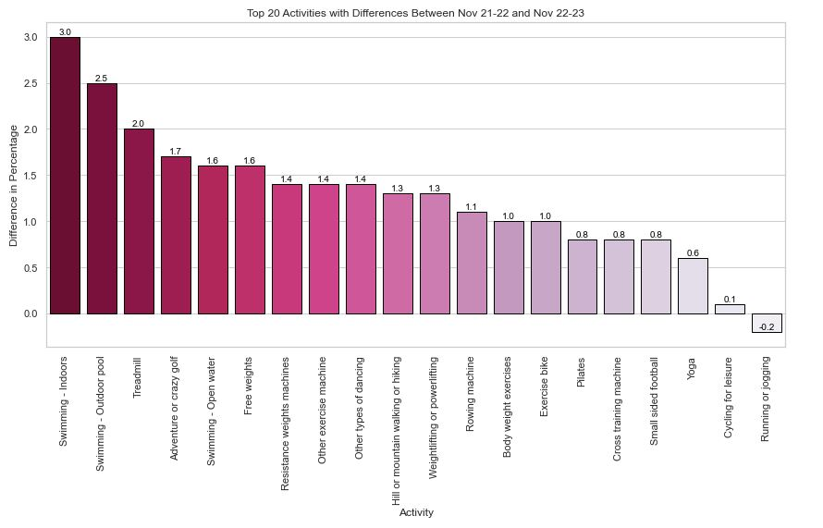
Whole population compare 2021 – 2022 and 2022 – 2023:
The top 10 activities for Nov 2022-2023:
Hill or mountain walking or hiking (25.3%) increased by 1.3%
Swimming – Indoors (20.6%) increased by 3%
Body weight exercises (17.2%) increased by 1%
Running or jogging (16.5%) decreased by -0.2%
Treadmill (15.2%) increased by 2%
Free weights (14.7%) increased by 1.6%
Exercise bike (14.0%) increased by 1%
Other exercise machine (13.4%) increased by 1.4%
Other types of dancing (11.7%) increased by 1.4%
Cycling for leisure (11.1%) increased by 0.1%
This barplot shows the difference in percentage from Nov 2021-2022 and Nov 2022-23. We can see the following activities are rising in popularity: Swimming (Indoors, Outdoors and Open Water), Treadmill and Adventure or crazy golf.
Datasets: https://activelives.sportengland.org/

Slide 9
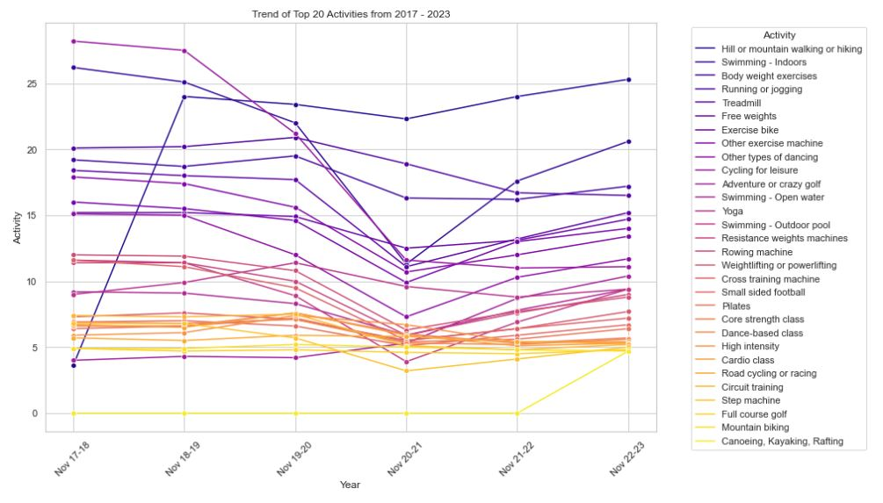
Whole population compare all years from 2017 – 2023:
The lineplot shows all years (2017 – 2023) plotted against the Activity (%) for the top 20 Activities.
We can see from the lineplot that there is a sharp decrease in Activity counts during Nov 19-20. This correlates with the COVID-19 Pandemic during which the country was in Lockdown with no or limited access to leisure facilities.
Post-Covid lockdowns (Nov 20-21) the data shows that activities increased. However, running or jogging continued to decline.
This trend continues in recent years (Nov 22-23):
Running or jogging (16.5%) decreased by -0.2%.
Whereas Treadmill (15.2%) increased by 2%.
Datasets: https://activelives.sportengland.org/

Slide 10
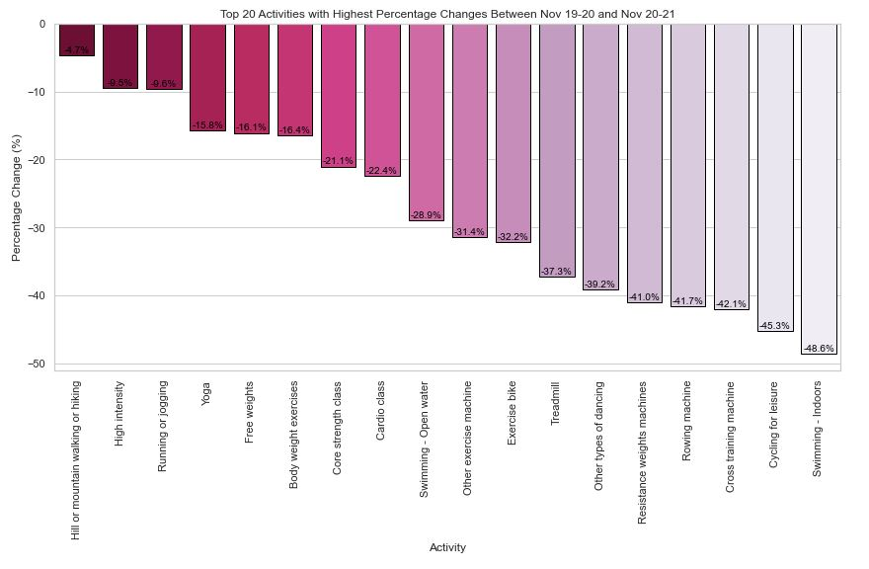

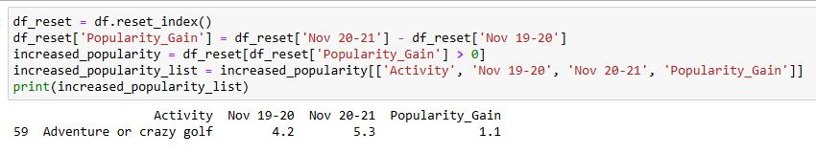
Whole population 2019 – 2020 and 2020-2021 (covid-19 pandemic):
The highest decrease during COVID-19 for Activity counts was indoor swimming. This was followed by cycling for leisure, cross training machine, rowing machine, resistance weights machine, dancing, treadmill and exercise bike.
Fitness classes (like dance), gym exercise equipment and indoor pools would have been closed during lockdowns.
Adventure or crazy golf was the only activity to gain popularity during the COVID-19 Pandemic.
Datasets: https://activelives.sportengland.org/

Slide 11
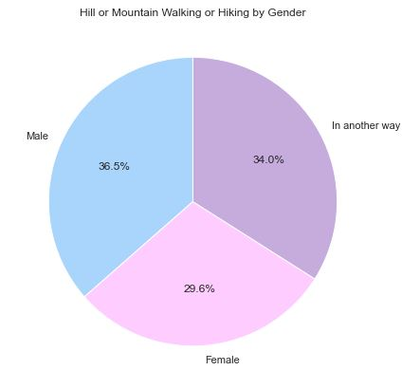
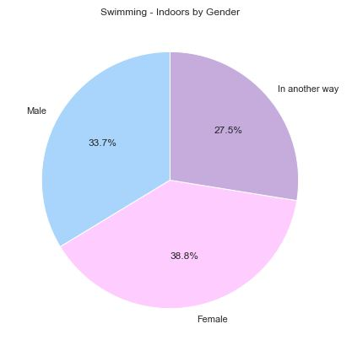
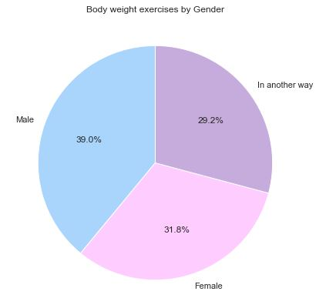
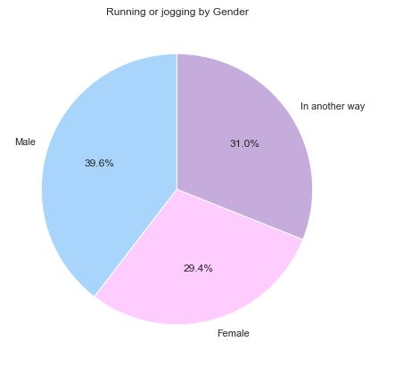
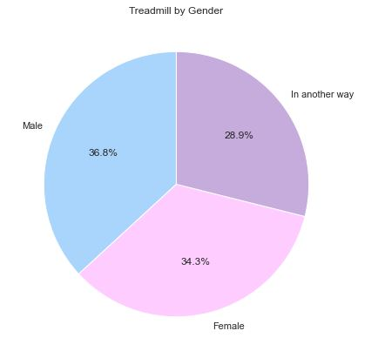
gender nov 2022-2023
The top 5 activities which adults participated in during 2022 – 2023 are Hill or mountain walking or hiking (25.3%), Swimming – Indoors (20.6%), Body weight exercises (17.2%), Running or jogging (16.5%) and Treadmill (15.2%).
The pie charts show the distribution of genders (‘Male’, ‘Female’ or ‘In another way’) for the top 5 activities for the whole population.
For these activities, we can visually see there is relatively equal distribution between genders.
Datasets: https://activelives.sportengland.org/

Slide 12
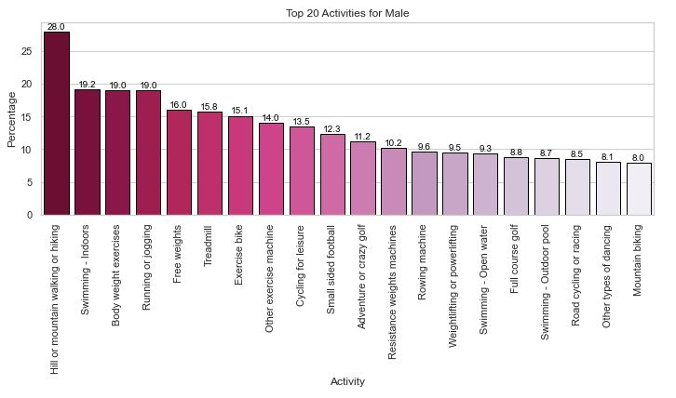
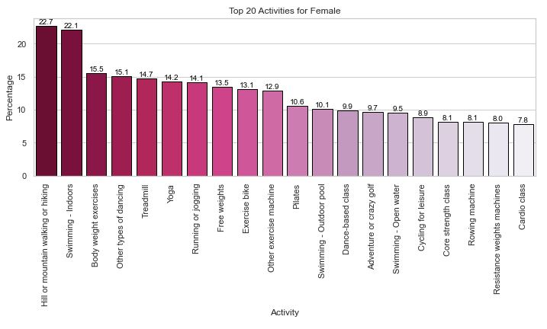
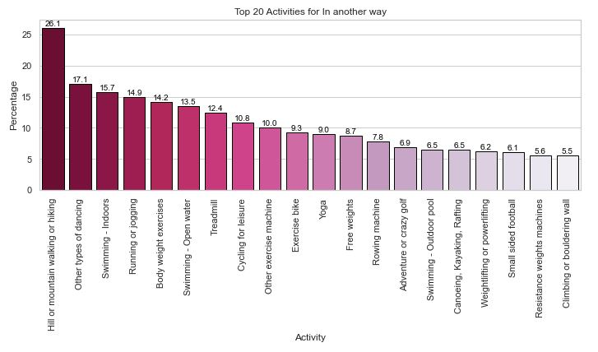
gender nov 2022-2023
Activities only appearing in male top 20:
Full course golf
Road cycling or racing
Mountain biking
Activities only appearing in female top 20:
Cardio class
Dance-based class
Core strength class
Pilates
Activities only appearing in other top 20:
Climbing or bouldering wall
Canoeing
Kayaking
Rafting
Datasets: https://activelives.sportengland.org/

Slide 13
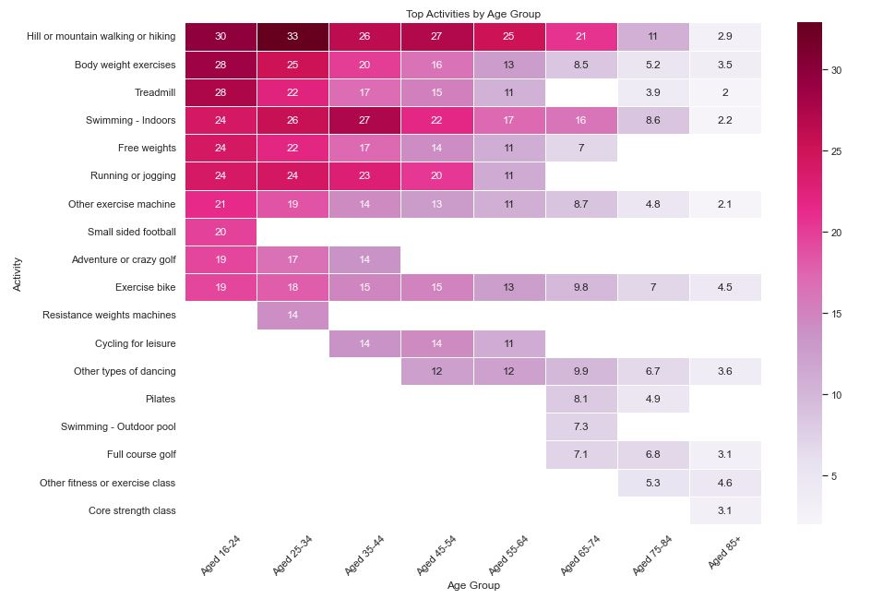
Age groups nov 2022-2023
The top 10 activities for each age group visualized in a heatmap.
Activities popular with younger and middle-aged adults (16-54):
Hill or mountain walking or hiking
Body weight exercises
Treadmill
Swimming – Indoors
Free weights
Activities popular with older adults (55-85+):
Other types of dancing
Pilates
Swimming – Outdoor pool
Full course golf
Other fitness or exercise class
Datasets: https://activelives.sportengland.org/

Slide 14
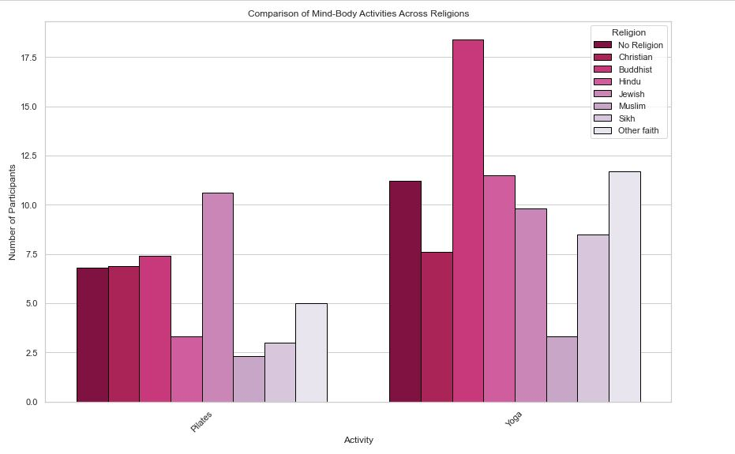
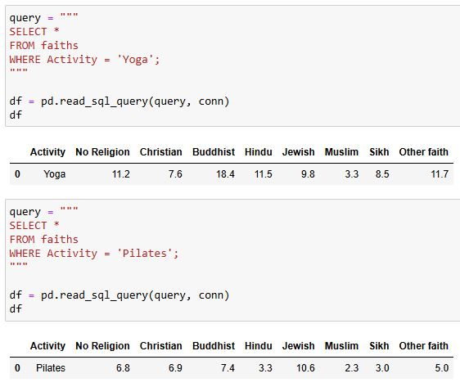
Faiths nov 2022-2023
Barplot to show Mind-Body Activities Across Religions
SQL code to find the % of different faith groups for mind-body activities
e.g., Yoga and Pilates.
The highest % that participate in Yoga are Buddhist (18.4%)
The highest % that participate in Pilates are Jewish (10.6%)
Datasets: https://activelives.sportengland.org/

Slide 15
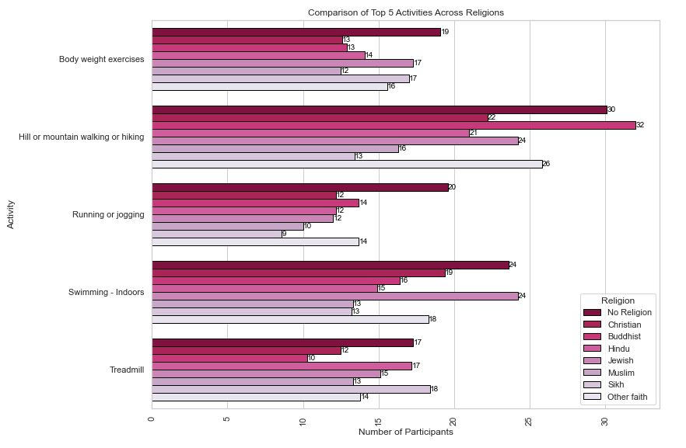
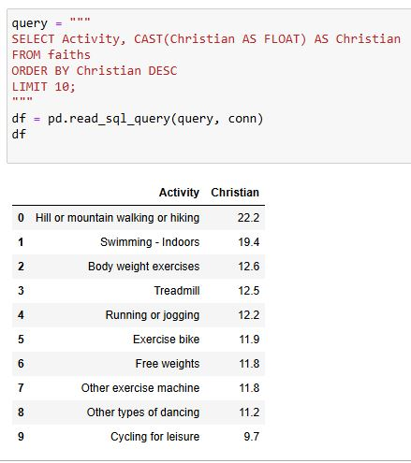
Faiths nov 2022-2023
SQL code to find the Top 10 Activities participated in by Christians.
Body weight exercises are most popular in No Religion group (19%).
Walking exercises are most popular with Buddhists (32%)
Running/jogging is most popular in No Religion group (20%)
Swimming is most popular in No Religion and Jewish groups (24%)
Treadmill is most popular with Sikhs (18%)
Datasets: https://activelives.sportengland.org/

Slide 16
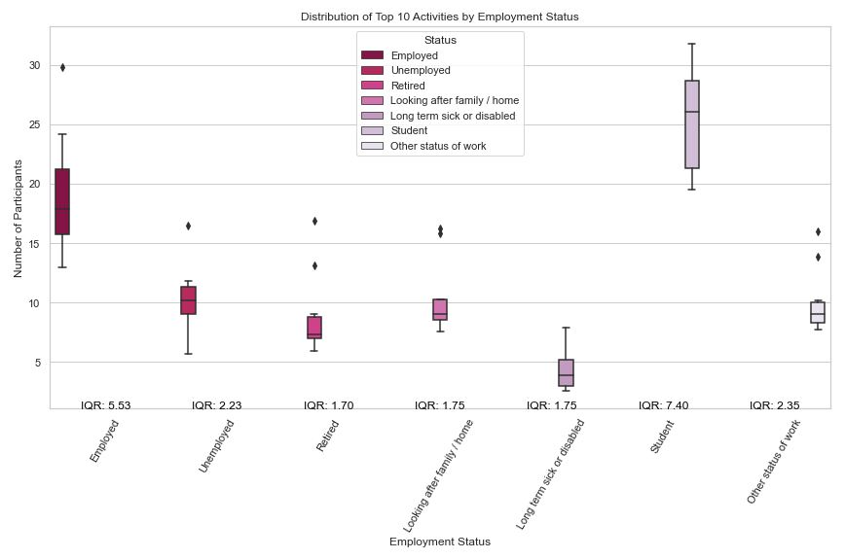
Employment status nov 2022-2023
The boxplot shows the distribution of the Top 10 Activities by Employment Status.
What does IQR tell us?
The Interquartile Range (IQR) is a measure of statistical dispersion or how spread out the data is. Calculation: IQR = Q3 - Q1
If the IQR is large, it indicates a wider spread in the middle 50% of your data, whereas a small IQR indicates that the middle 50% of the data is closely grouped. For example, Students have the largest IQR: 7.40 which indicates a wider spread in data as represented by a longer bar.
Visually, we can see that students also have higher levels of activity, with their box appearing further up in the graph. Whereas the box representing long term sick or disabled have the lowest levels of activity.
Datasets: https://activelives.sportengland.org/

Slide 17
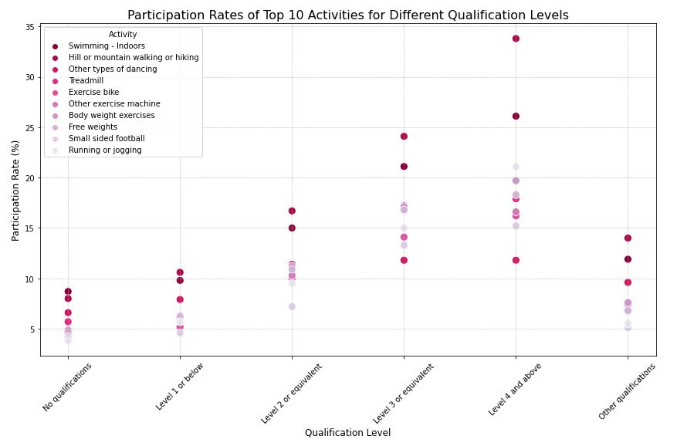
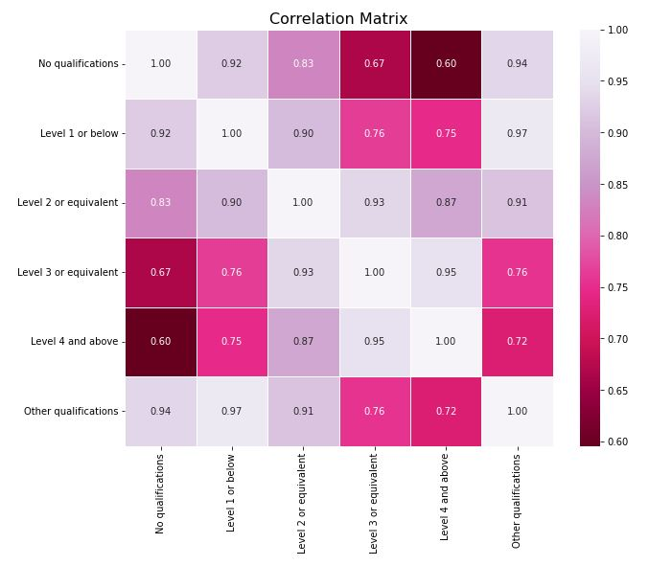
Qualification levels nov 2022-2023
The scatterplot shows the participation rates of the Top 10 Activities by Qualification Levels
There is a positive correlation between higher qualification levels and increasing activity levels as seen in the scatterplot.
This correlation matrix and the heatmap help to visualize how closely linked different education levels are to various activities. Positive correlations will show that as education level increases, activity participation increases, and vice versa.
Datasets: https://activelives.sportengland.org/

Slide 18
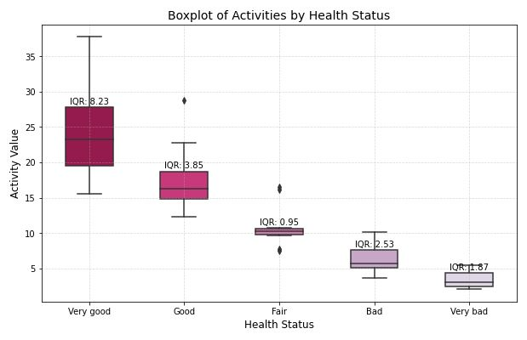
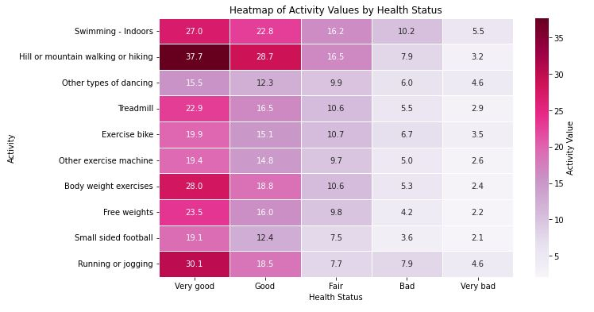
Health status nov 2022-2023
The boxplot shows the distribution of activity participation by Health Status.
The heatmap shows that walking and running activities are popular amongst those with Very Good Health/Good Health. In contrast, Swimming is an activity preferred by those with Fair/Bad/Very Bad Health.
Datasets: https://activelives.sportengland.org/

Slide 19

Project conclusion summarizing the key findings
Whole population from 2017 – 2023:
The following activities are rising in popularity: Swimming (Indoors, Outdoors and Open Water), Treadmill and Adventure or crazy golf.
There was a sharp decrease in Activity counts during Nov 19-20. This correlates with the COVID-19 Pandemic during which the country was in Lockdown with no or limited access to leisure facilities. Adventure or crazy golf was the only activity to gain popularity during the COVID-19 Pandemic.
Gender: Activities only appearing in male top 20: Full course golf, Road cycling or racing and Mountain biking.
Activities only appearing in female top 20: Cardio class, Dance-based class, Core strength class and Pilates.
Activities only appearing in other top 20: Climbing or bouldering wall, Canoeing, Kayaking and Rafting
Age groups: Activities popular with younger and middle-aged adults (16-54):
Hill or mountain walking or hiking, Body weight exercises, Treadmill, Swimming – Indoors and Free weights.
Activities popular with older adults (55-85+):
Other types of dancing, Pilates, Swimming – Outdoor pool, Full course golf, Other fitness or exercise class
Datasets: https://activelives.sportengland.org/

Slide 20

Project conclusion summarizing the key findings
Faiths (Mind-Body Activities): The highest % that participate in Yoga are Buddhist (18.4%). The highest % that participate in Pilates are Jewish (10.6%)
Education Levels: There is a positive correlation between higher qualification levels and increasing activity levels.
Employment Status: students have higher levels of activity. Whereas long term sick or disabled have the lowest levels of activity.
Health Status: Walking and running activities are popular amongst those with Very Good Health/Good Health. In contrast, Swimming is an activity preferred by those with Fair/Bad/Very Bad Health.
Datasets: https://activelives.sportengland.org/

Slide 21


Thank you any questions or feedback please contact: beckypotter@hotmail.co.uk
Datasets: https://activelives.sportengland.org/

